Slide 1
Session Six: Employees Motivation
  Motivation -Motivation is the set of forces that causes people to behave in certain ways.
  Motivation is a way of creating high level of enthusiasm to reach organizational goals, and this situation is accommodated by satisfying some individual need. Basically, motivation refers to achieve organizational main goals by satisfying individual employee’s needs or demands.
Notes:
2
2
6
6
6
6

Slide 2

Example

Slide 3
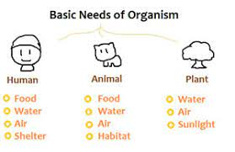
Content Versus Process Motivation Theories
Content theories (need theories)
  Explain why people have different needs at different times

Slide 4


Content Versus Process Motivation Theories
Process theories (behavioral theories)
  Describe the processes through which needs are translated into behavior

Slide 5
Hierarchy of need Theory (A.H.Maslow, 1943)
Hierarchy of needs theory is proposed by Abraham Maslow in his paper titled "A Theory of Human Motivation" published in Psychological Review in 1943.
Maslow’s Hierarchy of needs is one of the best known motivation theories.
Maslow proposed that there are five different levels of needs people have to seek for satisfaction of their basic needs.
The core of this theory lies in the fact that when one need is fulfilled, its strength diminishes and the strength of the next level increases.

Slide 6
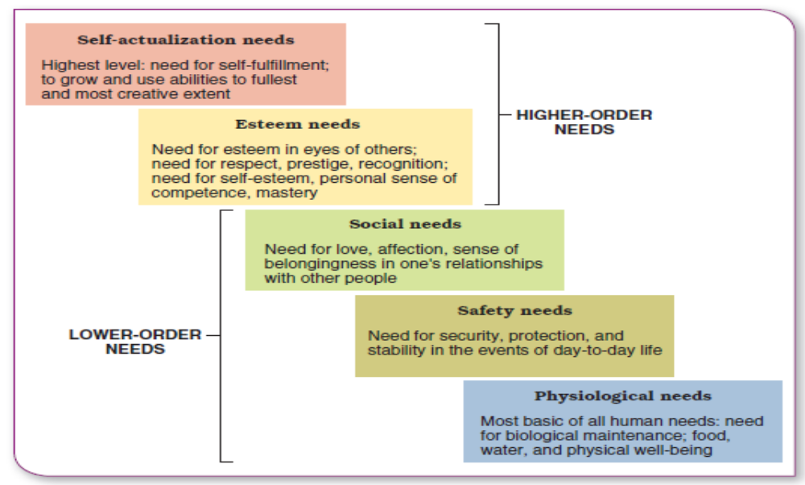
Maslow’s hierarchy of human needs

Slide 7
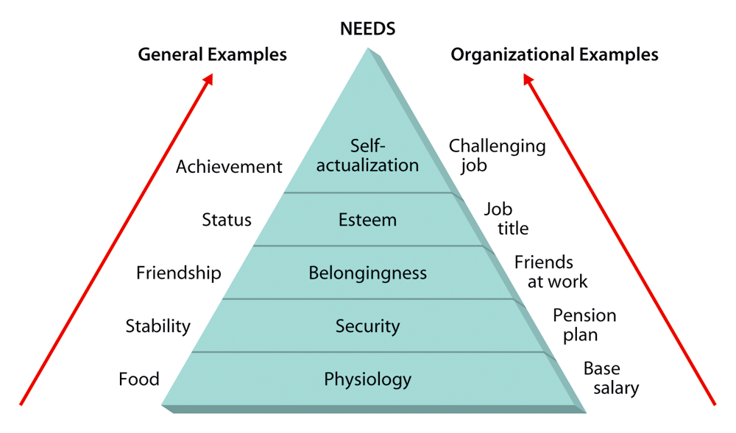
Maslow’s Hierarchy of Needs

Slide 8
Explanations of Maslow’s Hierarchy of Needs
• Physiological needs refer to the need for food, water, and other biological needs. These needs are basic.
• Once physiological needs are satisfied, people tend to become concerned about safety needs.
• Belongingness and love needs also called social needs. Social needs refer to the need to bond with other human beings, be loved, and form lasting attachments with others.
• The satisfaction of social needs makes esteem needs more noticeable. Esteem need refers to the desire to be respected by others, feel important, and be appreciated.
• Self-actualization need exhibits itself by the desire to acquire new skills, take on new challenges, and behave in a way that will lead to the attainment of one’s life goals.
Notes:
7
5
2
2
2
5

Slide 9
Existence, Relatedness and Growth theory
(Clayton Alderfer, 1969)
This theory is given by Clayton Alderfer.
It is a variation of Maslow's hierarchy of needs.
Alderfer expanded Maslow’s basic needs and refined them into existence needs, relatedness needs, and growth needs.

Slide 10
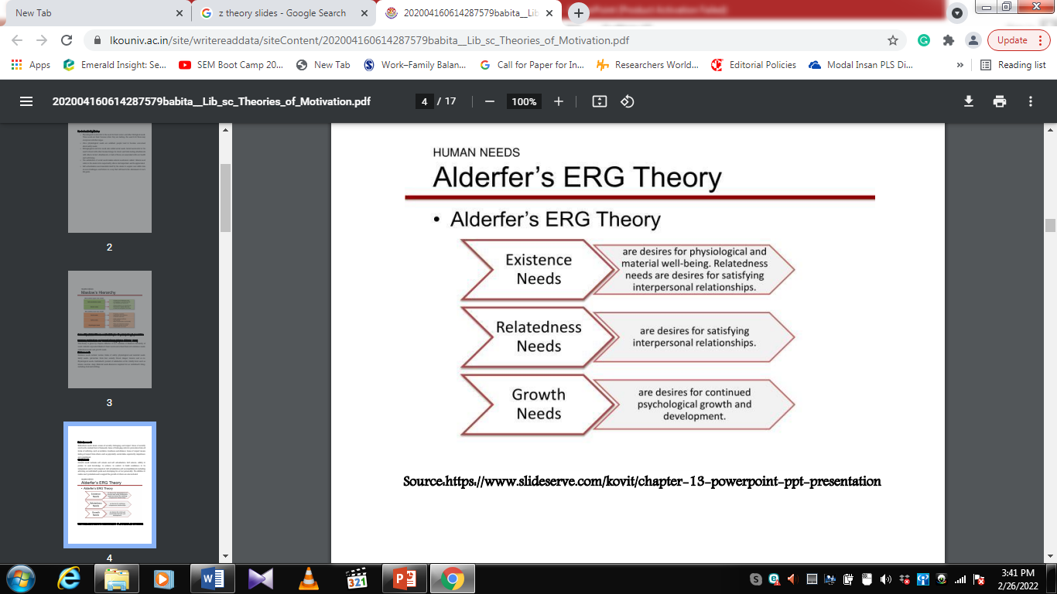
Alderfer’s ERG theory

Slide 11
Explanations of ERG theory
Existence needs include various forms of safety, physiological and physical needs. Safety needs- prevention from fear, anxiety, threat, danger, tension, and so on. Physiological needs- Individual’s. pursuit of satisfaction at the vitality level, such as leisure, exercise, sleep. Material needs-Resources required for an individual’s living, including food and clothing.
Relatedness needs means senses of security, belonging, and respect. Sense of security involves the mutual trust of humanity. Sense of belonging refers to prevention from all forms of suffering, such as isolation, loneliness and distance. Sense of respect means feeling of respect from others, such as popularity, social status, superiority, importance and compliment.
Growth needs includes self esteem and self actualization. Self esteem- ability to pursue, to seek knowledge, to achieve, to control, to build confidence, to be independent and to feel competent. Self actualization-self accomplishments including achieving an individual’s goals and developing his or her personality. The abilities to realize one’s potentials and to support the growth of others are also included.

Slide 12
Alderfer’s ERG Theory with Maslow’s Hierarchy of Needs
SA
Growth
Esteem
Relatedness
Love (Social)
Safety & Security
Existence
Physiological
Notes:
10

Slide 13
Achievement Motivation Theory (David C.Mc Clelland, 1980s)
David McClelland was an American psychologist who created a theory in year 1980s that attempts to explain how the needs for achievement, power and affiliation affect the human motivation and the actions of people.
The McClelland Human Motivation Theory also referred as “the three social motives” or “Acquired Need Theory”. The Three Social Motives are described as:

Slide 14
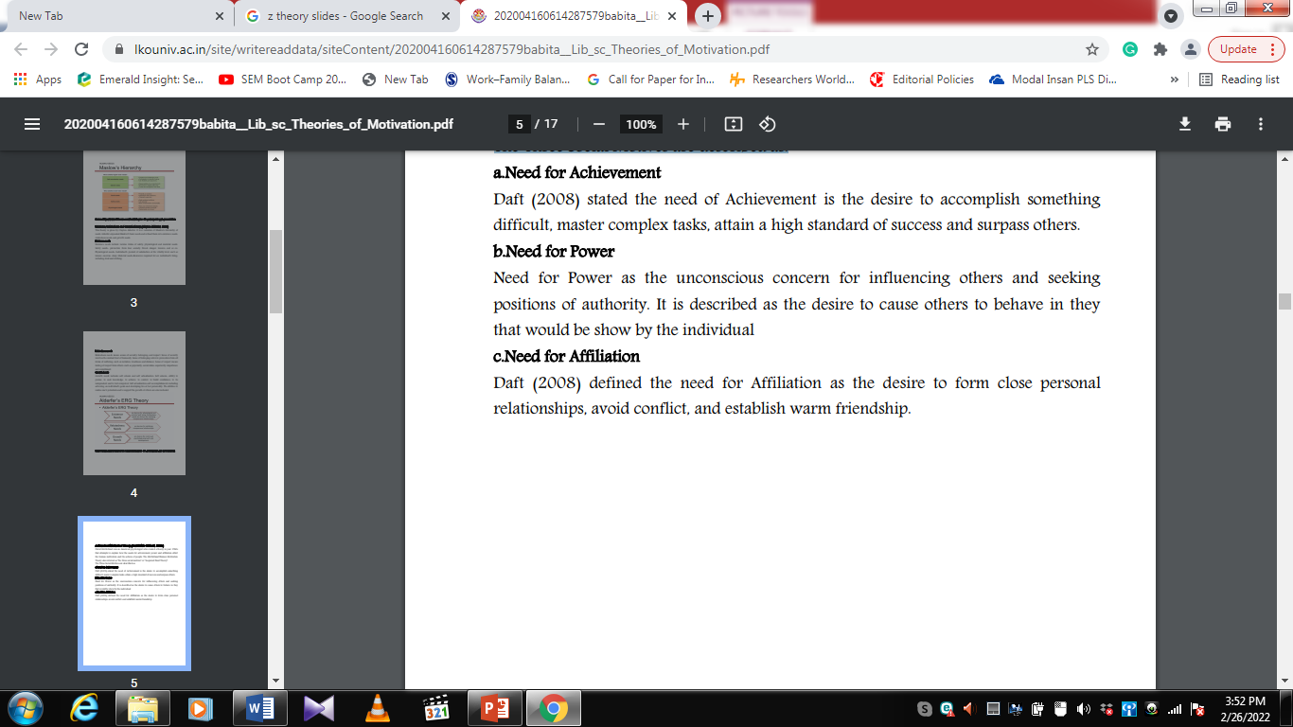
McClelland’s Need Theory:
Need for Achievement
Notes:
15
2
6
6
6
6

Slide 15
McClelland need theory with Maslow’s Hierarchy of Needs
Maslow
McClelland
Self-actualization
Need for
Achievement
Higher
Order
Needs
Esteem
self
interpersonal
Need for
Power
Belongingness
(social & love)
Need for
Affiliation
Lower
Order
Needs
Safety & Security interpersonal
physical
Physiological
Notes:
18

Slide 16
Two Factor Theory (Frederick Herzberg, 1959)
Frederick Herzberg’s well known Two-Factor Theory was designed in year 1959.
Herzberg’s Motivation Theory model goes by a number of different names, including Two Factor Theory, Herzberg’s Motivation-Hygiene Theory and Duel Structure Theory.
Based on two hundred engineers and accountant feedback collected in the USA regarding their personal feelings towards their working environments, Herzberg defined two sets of factors named Motivation & Hygiene Factors.
According to Herzberg full supply of Hygiene Factors will not necessarily result in employees’ job satisfaction. In order to increase employees’ performance or productivity, Motivation factors must be addressed.

Slide 17
Herzberg’s Two-Factor Theory
Hygiene Factor - work condition related to dissatisfaction caused by discomfort or pain
  maintenance factor
  contributes to employee’s feeling
  contributes to absence of complaints
Motivation Factor - work condition related to the satisfaction of the need for psychological growth
  job enrichment - giving employees increased responsibility and variety in their jobs
  leads to superior performance & effort
Notes:
11
9

Slide 18
Motivation–Hygiene
Theory of Motivation
Company policy &
administration
Supervision
Interpersonal relations
Working conditions
Salary
Status
Security
Motivation factors increase job satisfaction
Achievement
Achievement recognition
Work itself
Responsibility
Advancement
Growth
Hygiene factors avoid
job dissatisfaction
SOURCE: Adapted from Frederick Herzberg, The Managerial Choice: To be Efficient or to Be Human. (Salt Lake City: Olympus, 1982). Reprinted by permission.
Notes:
13
10

Slide 19
Content Theories of Motivation
Maslow’s
Need Hierarchy
Alderfer’s
ERG Theory
Herzberg’s
Theory
McClelland’s
Learned Needs
Self-
Actualization
Growth
Motivators
Need for
Power
Esteem
Need for
Achievement
Belongingness
Relatedness
Hygienes
Need for
Affiliation
Safety
Existence
Physiological

Slide 20
Process or Behavioral Management Theories/Approaches
Theory X and Theory Y (Douglas Mc Gregor, 1960)
Douglas McGregor proposed two theories by which to view employee motivation in his 1960 book titled “The Human Side of Enterprise”.
Theory X and Theory Y. Both of these theories begin with the premise that management's role is to assemble the factors of production, including people, for the economic benefit of the firm.

Slide 21
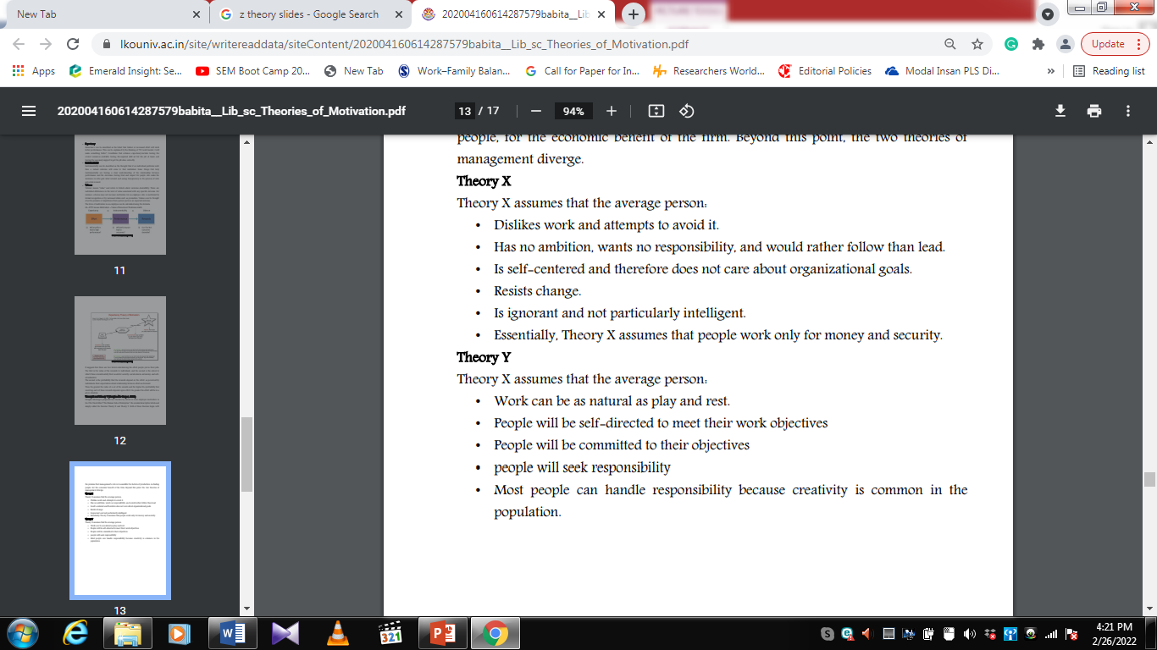

Slide 22
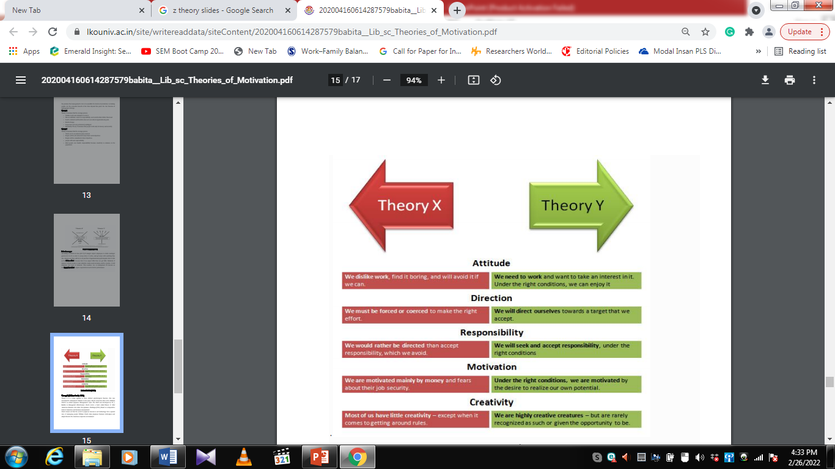

Slide 23
What is the impact of Theory X and Theory Y Type Leadership Behavior on Bangladeshi Organizational Performance? Assume any local company (for example: Shwapno, Agora, Square, ACI, Rupayon any any organization of your choice. Which theory is more suitable for your preferred organization? Explain your answer with logical explanation and examples (2 pages maximum).

